Slide 1
The SMART Skateboard
Group 6

Slide 2
Project Group Members
Matias “Nick” Canter | nickcanter3@knights.ucf.edu | EE
Brandon Carty | bccarty218@knights.ucf.edu | EE
Jonathan Espinal | Espinal_j@knights.ucf.edu | EE
Taymas Musaev | tmusaev@knights.ucf.edu | CpE

Slide 3
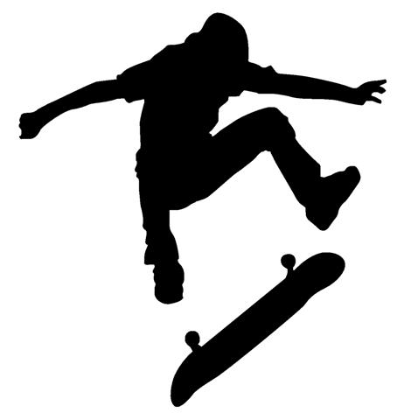
Project Introduction & Goals
Our main goal is to design a smart device that anyone can easily attach to the bottom of their skateboard.
This device will link to a mobile app. Using the phone’s memory, it will keep track of past tricks the user has landed and also keep track of the user’s speed, acceleration, and trick height.
The SMART Skateboard will be an inexpensive device that can link to the user’s mobile phone and keep track of the tricks that have been landed.

Slide 4
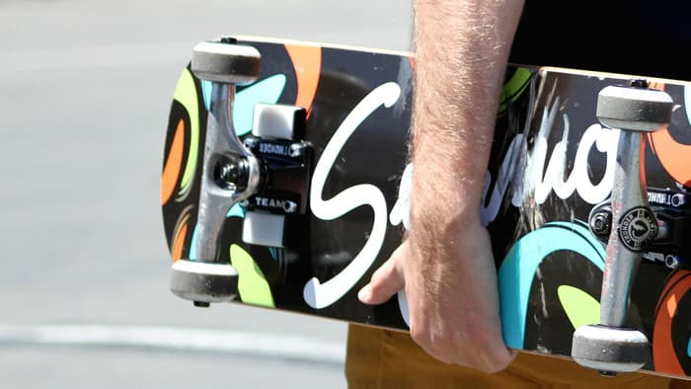
Motivation
In the past, skateboarders had no way of logging the tricks they landed, unless they had a cameraman nearby.
There has yet to be a full tech revolution in the skateboarding industry.
Some companies have tried, all have failed. (i.e. Syrmo)
Similar products were too intricate, creating increased costs leading to failure.
We wanted to have a design that could succeed where others have failed, while also fully testing our engineering capabilities.
Copyright:Syrmo

Slide 5
Basic Skateboarding Tricks Explained
Ollie - executed by pushing the back foot down on the tail of the board, bringing the board off the ground
Kickflip - board is manipulated by the feet during a jump so that it spins sideways through 360 degrees
Heelflip - front heel is used to manipulate the board during a jump in such a way that it completes a sideways rotation
Pop Shuvit - user makes the board spin 180 degrees underneath his/her feet
360 Shuvit - user makes the board spin 360 degrees underneath his/her feet

Slide 6
SMART Skateboard Requirements
Device should have negligible weight to the user
Enough power to last for an entire skating session
Durable enough to withstand the impact endured from regular use
Accurate enough to detect slight differences in tricks
The mobile application should have a low latency and high range
The overall cost of the device must be reasonable.

Slide 7
SMART Skateboard Specifications
Component | Parameter | Design Specification
Entire Device | Total Weight | Under 32 ounces
Entire Device | Impact Resistance | 5 foot free-fall
Entire Device | Cost | Under $250
Battery | Lifetime | At least 5 hours
Motion Sensors | Accuracy | Within 10%
Wireless Sensors | Range | At least 6 feet
Software | Latency | Under 5 seconds
Notes:
Ideally aiming to keep the device under 250$
Range/latency

Slide 8
System Block Diagram
The rotation, speed, acceleration, and height of the skateboard will be gathered by the motion sensors on the device as analog signals.
These signals will be received by the microcontroller as digital data.
These digital signals are then passed on to the wireless chip.
The data will then be received by the mobile device (Android phone) via mobile app.
The app will run an algorithm to decipher the digital signals as information the user can interpret.

Slide 9
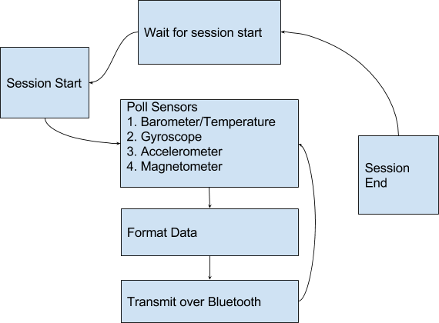
System Block Diagram
Embedded:

Slide 10
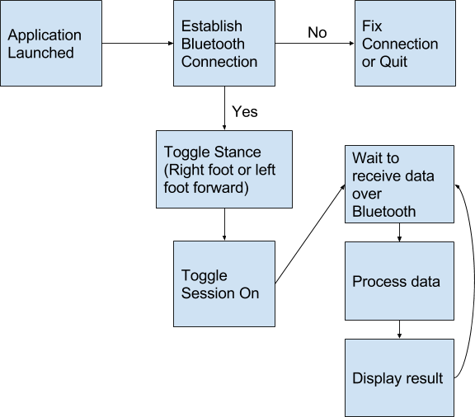
System Block Diagram
Mobile:

Slide 11
Approach/Implementation
The following covers major milestones achieved during the development process:
Test MCU for proper functionality
Configure BLE module along with the required sensors (gyroscope, accelerometer, barometer)
Optimize the design of our SMART device
Integrated power source to ensure entire device can be mobilized
Confirmed orientation capabilities
Notes:
Ran a few tests on the microcontroller for proper functionality
Configure module/sensors & optimized our breadborad design
Ensured device can be mobilized & confirmed orientation capabilities

Slide 12
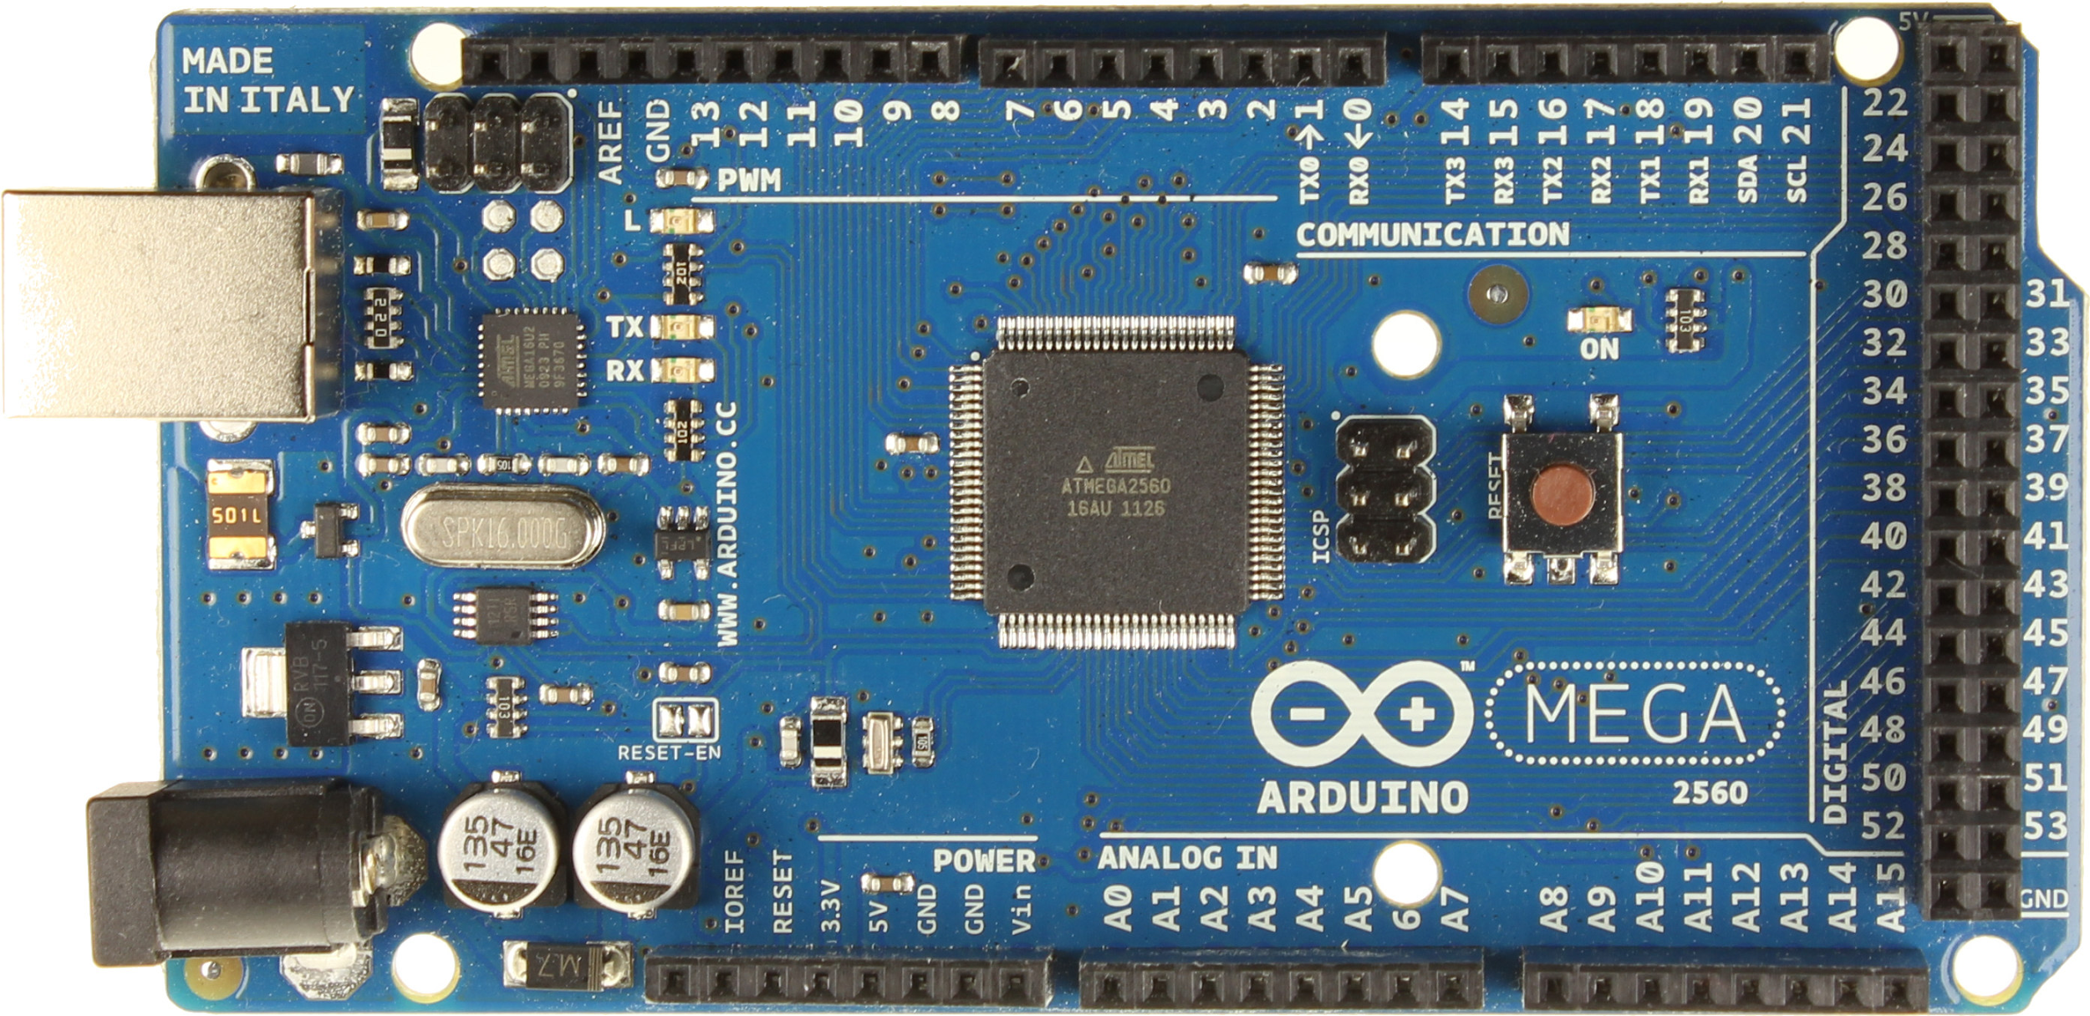
Arduino Mega (not selected)

Slide 13
Arduino Mega (not selected)

Slide 14
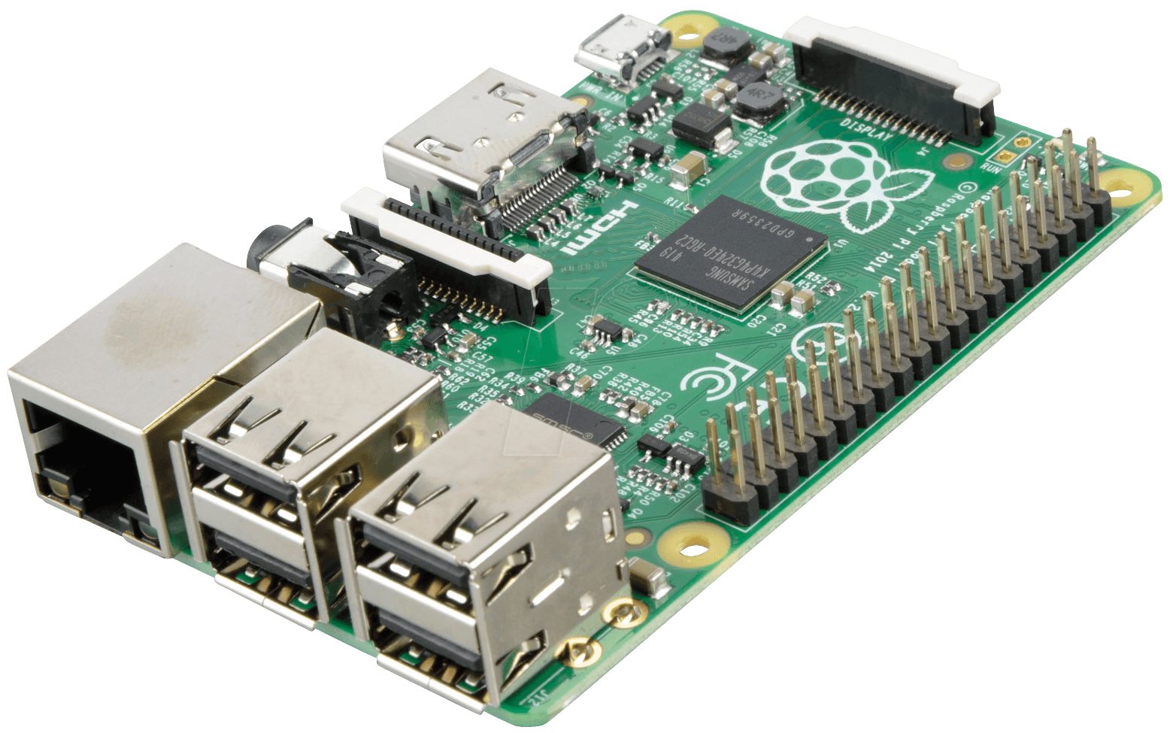
Raspberry Pi
(not selected)

Slide 15
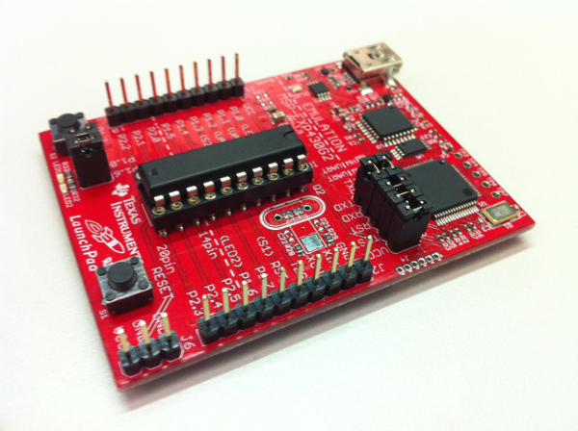
TI MSP430 (not selected)

Slide 16
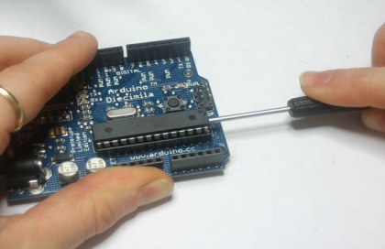
Arduino Uno (selected)

Slide 17
Sensor Selection
Gyroscope | Features | Accelerometer | Function | Barometer | Function
LSM303 | Standby Mode Low Power Consumption 3 Axes of sensitivity | ADXL377 | Wide Range Measurement Easy Implementation | MPL225A1 | Low Power consumption Low latency
Maxim Integrated MAX21000 | Small in size No external Components needed Minimal delay | L3GD20H | Low Noise Wake on shake Feature | BMP180 | High Accuracy Factory calibrated
SparkFun MLX90609 Gyro Breakout Board | Low Zero rate Output drift On-chip calibration capability Wide operating temp range | ADXL362 | Minimal size Requirement Low Current Draw | N/A | N/A

Slide 18
Wireless Technology Selection
Technology | Selected? | Reason
Wi-Fi | NO | Long range unnecessary, high power consumption
Bluetooth LE | YES | Easy to integrate in software, low power consumption
VS
Notes:
create an easy wireless link between devices
Helps to minimize consumption rate

Slide 19
Power Supply Options and Selection
Option | Description | SMART Skateboard Impact
Switching, Unregulated, & Regulated converters and all other converters. | AC-DC converters that plug into the wall | A wall plug can only be beneficial for our design is terms of charging the device.
Alkaline/ Zinc Batteries | Typical battery seen in most convenience stores | Non-ideal voltage output. Non-rechargeable
Coin cell Lithium Batteries | Typical battery seen in digital watches | Non-ideal voltage output. Non-rechargeable
Lithium Polymer Batteries | Chemistry in most rechargeable batteries. Come in many different shapes | Many different voltage output options. Rechargeable. Minimal dimensions.

Slide 20
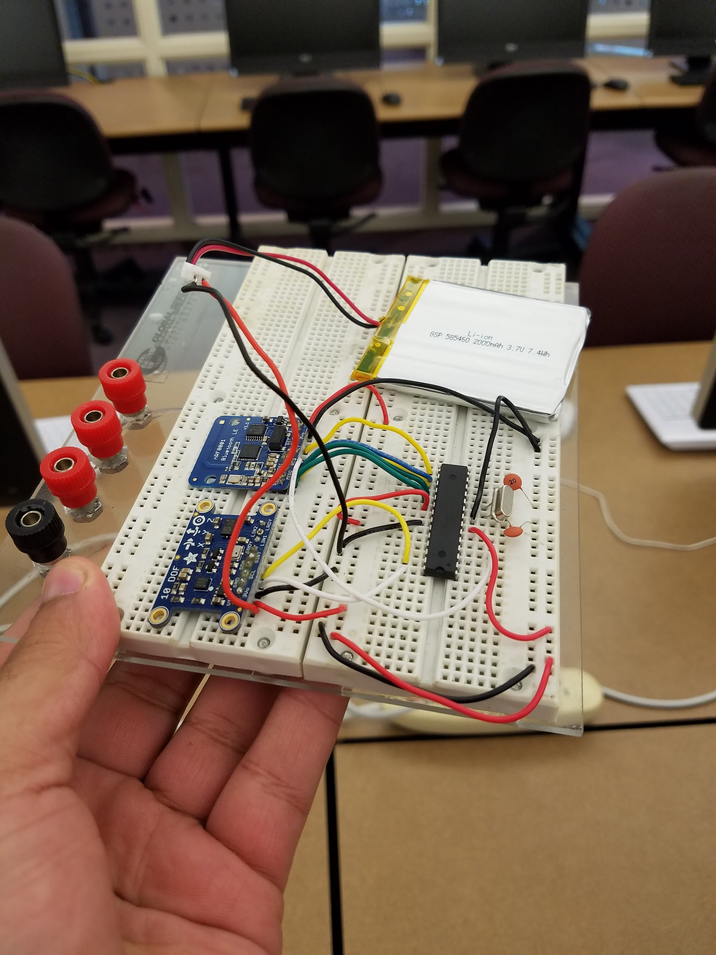
PCB Design/Schematics
The PCB design is the most imperative part of the project
Optimizing size and efficiency were priority
We initially breadboarded our design to run necessary tests:
Device recognition from mobile application
Functionality of the sensors via Bluetooth connection
Board positioning
The figure displays the prototype of our design with the required components

Slide 21
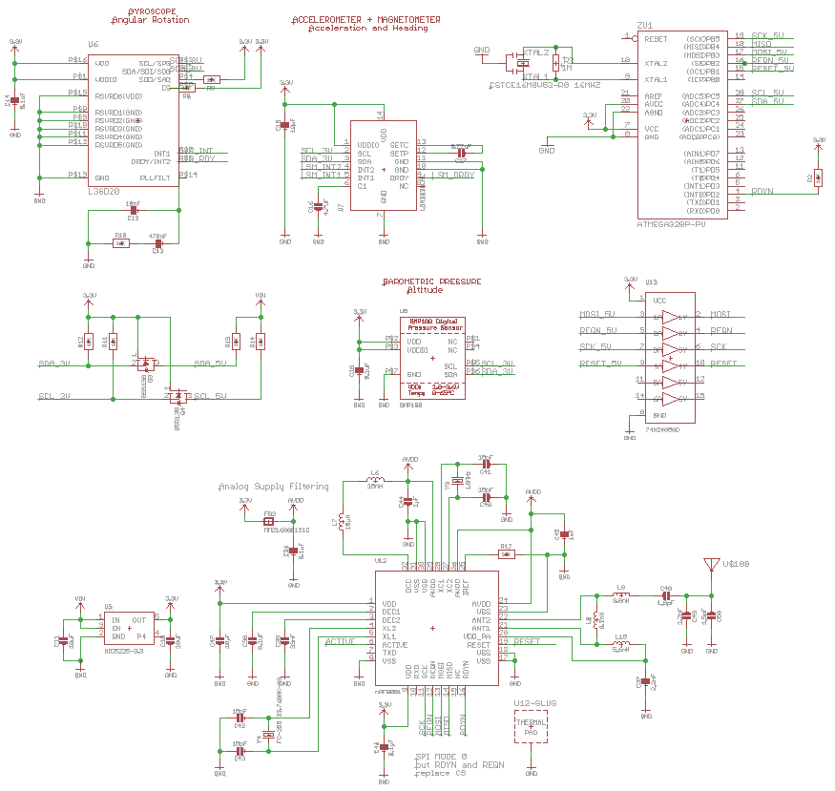
PCB Design/Schematics

Slide 22
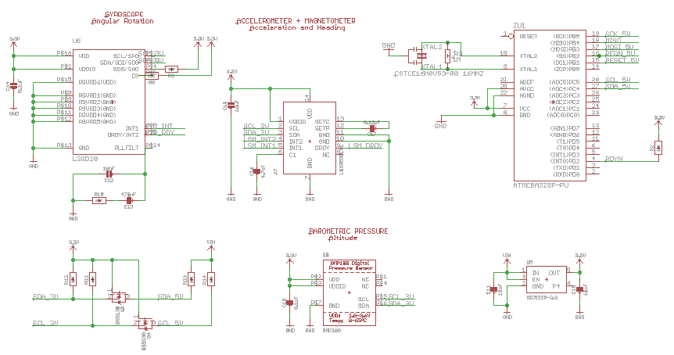
PCB Design/Schematics
Sensor Schematic

Slide 23
PCB Design/Schematics
Sensor Schematic

Slide 24
PCB Design/Schematics
Sensor Schematic

Slide 25
PCB Design/Schematics
Sensor Schematic

Slide 26
PCB Design/Schematics
Sensor Schematic

Slide 27
PCB Design/Schematics
Sensor Schematic
Notes:
level shifter is used to convert one voltage into another voltage

Slide 28
PCB Design/Schematics
Sensor Schematic
Notes:
voltage regulator is used to produce constant output voltage from high voltage

Slide 29
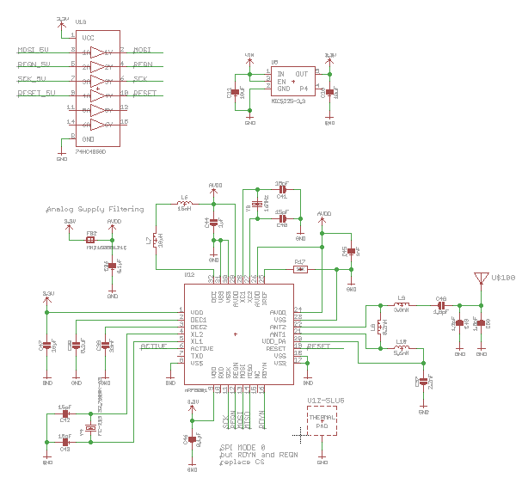
PCB Design/Schematics
Bluetooth Schematic

Slide 30
PCB Design/Schematics
Bluetooth Schematic

Slide 31
PCB Design/Schematics
Bluetooth Schematic

Slide 32
PCB Design/Schematics
Bluetooth Schematic

Slide 33
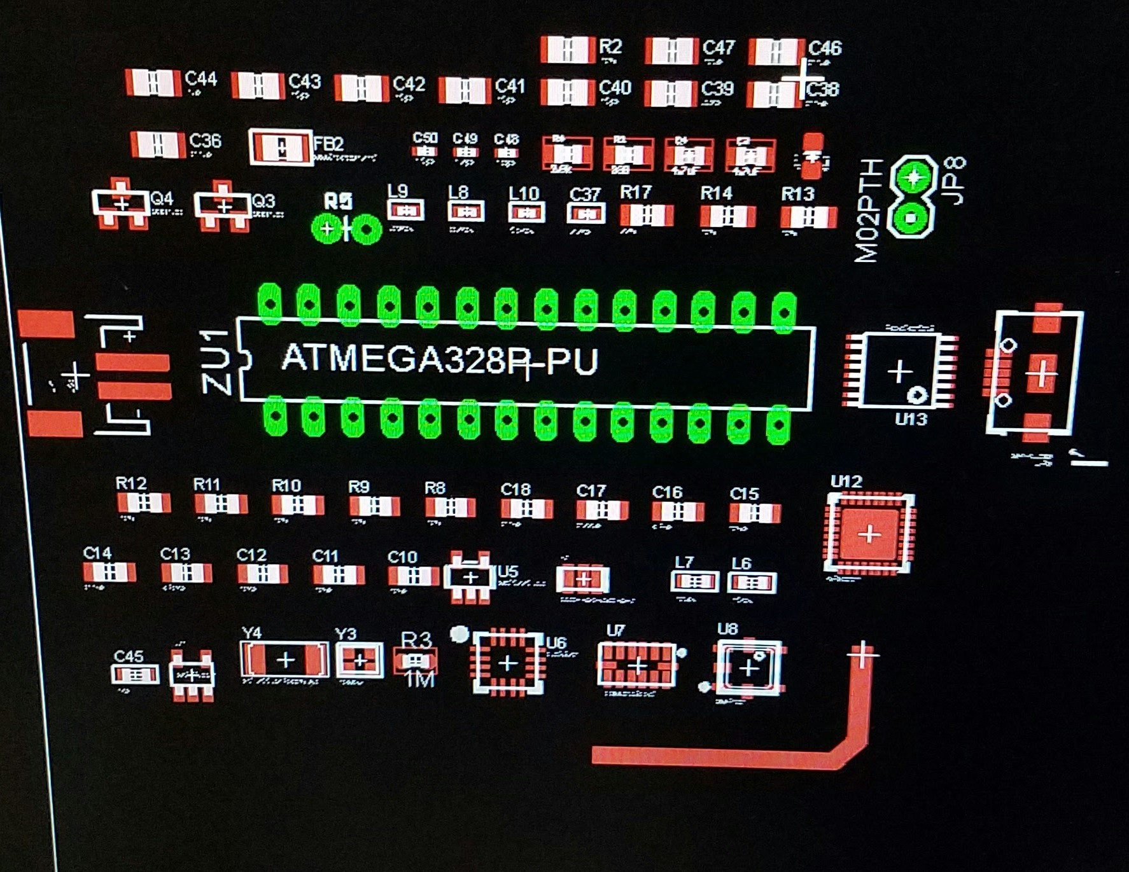
Initial Board design

Slide 34
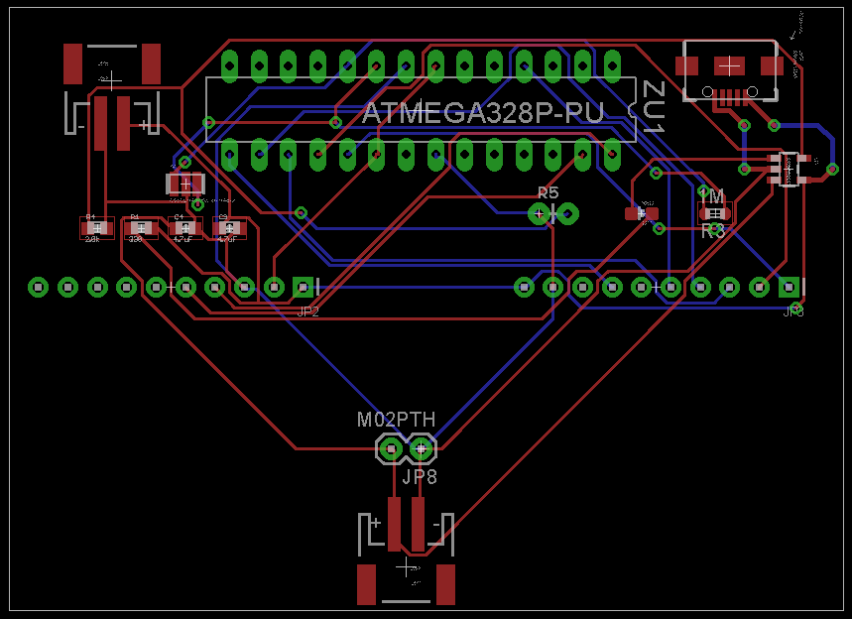
Final Board Design

Slide 35
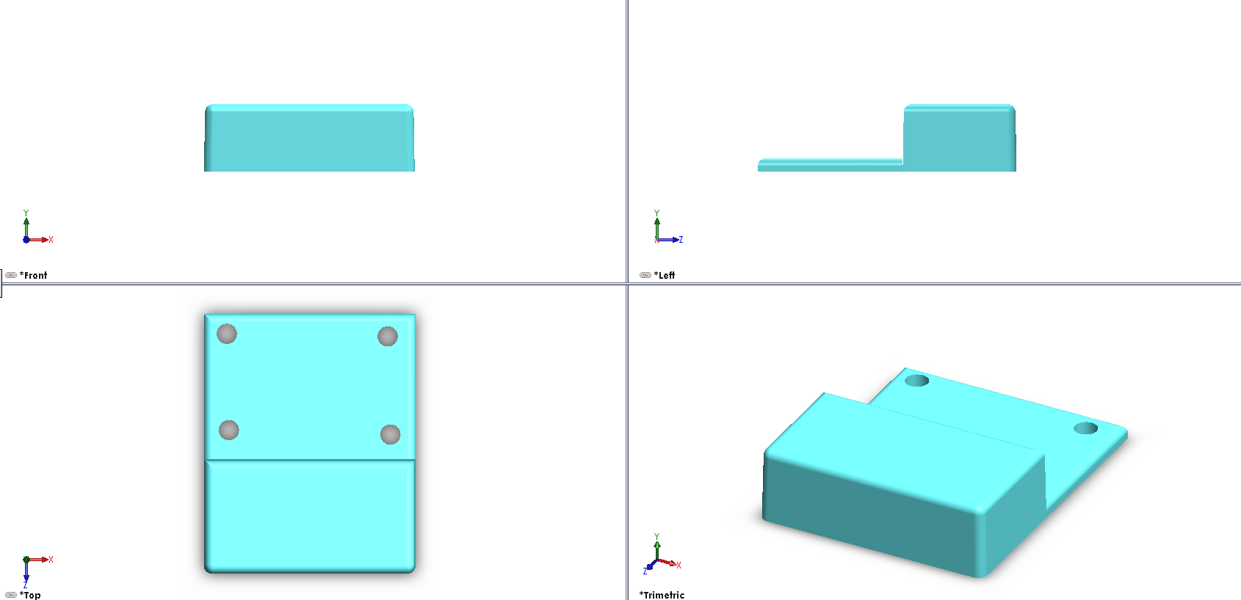
Initial Holster Design

Slide 36
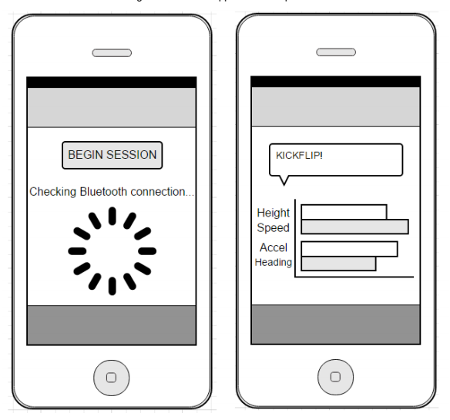
Mobile App Brainstorming

Slide 37
Software Development Environment
Unity:
3-D Game Engine Included
Easy to implement cross-platform compatibility
Scripting in C#

Slide 38
ANTICIPATED BUDGET
COMPONENT | PRICE
Processor/Microcontroller | $25.00
Accelerometer | $10.00
Gyroscope | $9.95
Barometer | $8.50
Battery | $12.95
Wireless Communication | $22.00
PCB Manufacturing | $60.00
Harness | $25.00
Miscellaneous | $35.00
Total Cost | $208.40

Slide 39
UP TO DATE BUDGET
Arduino Uno | $25.95
nRF8001 Bluetooth LE | $19.95
Gyroscope, Accelerometer & barometer | $29.95
Resistors/Capacitors | $5.00
PCB Manufacturing + Shipping | $41.60
Total | $122.45

Slide 40
Future Plans to Success
Order custom PCB
Design a holster that can enclose the entire device and resist constant impact
Test custom PCB
Finish the mobile application
(add z-axis for altitude, add speed, and full trick classification)
Integrate device into 3D printed holster
Implement the SMART Skateboard device onto a skateboard
Successfully demo the device

Slide 41
Possible Future Upgrades
1.) Create a point system for each trick.
2.) Make multiple devices link up to allow for competition.
3.) Develop algorithm for more complex tricks.
4.) Add a social timeline feature to the mobile application.
5.) Create a device for other sports (i.e. snowboarding, bmx, football, etc.)

Slide 42
Challenges
Creating a final holster design to 3D print
Holster needs to withstand constant impact
Creating the software to decipher each trick
Creating the software that can properly analyze the speed of the board
Keeping the error rate of the sensors under 10%
Keeping latency as low as possible (under 5 seconds)
Notes:
Lacking cad experience
Real-time results; keep the error rate of the sensors under 10%
delay between a completed trick and the display on the device be a maximum of 5 seconds

Slide 43
Division of Labor
Group Member | PCB and Sensor Design | Mobile App | Power Supply | Holster Design
Brandon | Primary |  | Secondary
John | Primary | Secondary
Nick | Secondary |  | Primary | Primary
Taymas | Secondary | Primary |  | Secondary

Slide 44
